Slide 1
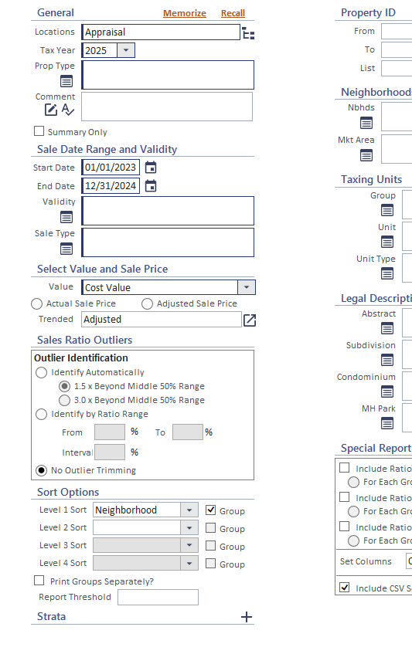
Orion
Sales Ratio
SH PRC
&
2024 ORION USERS CONFERENCE

Slide 2
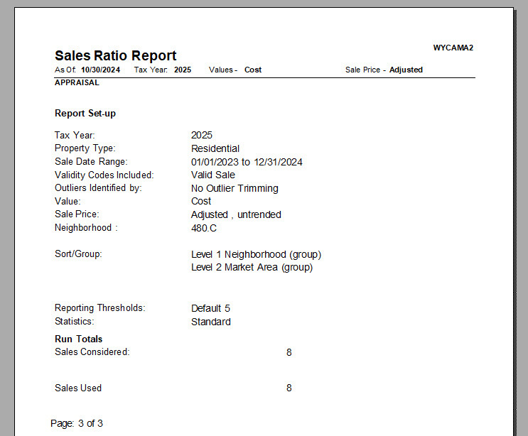
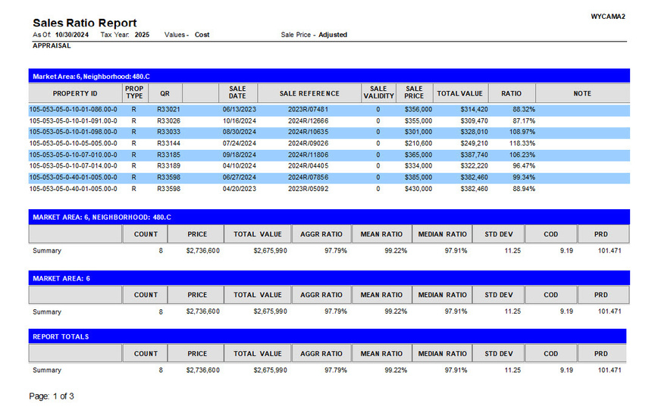
Sales Ratio Report
Each year there is talk about modifying this report feature.

Slide 3
Counties Utilizing Sales History
What Counties are using Orion’s Sales Ratio Report?
22 Counties Responded
2024 ORION USERS CONFERENCE

Slide 4
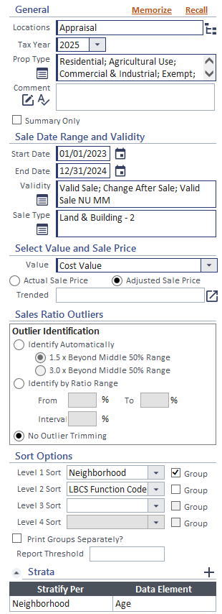
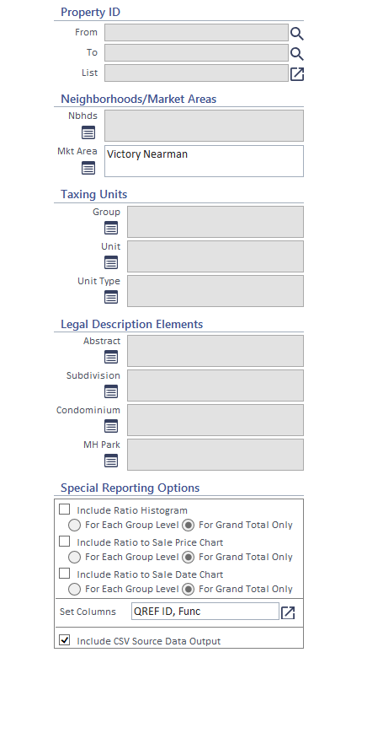
Change Requests
Additional parameters/sort options such as quality, physical, arch style, land types/infl, etc
Pull from sales history or add option to
Time trending
Is it working, multi year trends, and is there an easier way?
Ag land/other improvements are not included
Does not work with multiple parcel sales
A View button, not just Submit

Slide 5
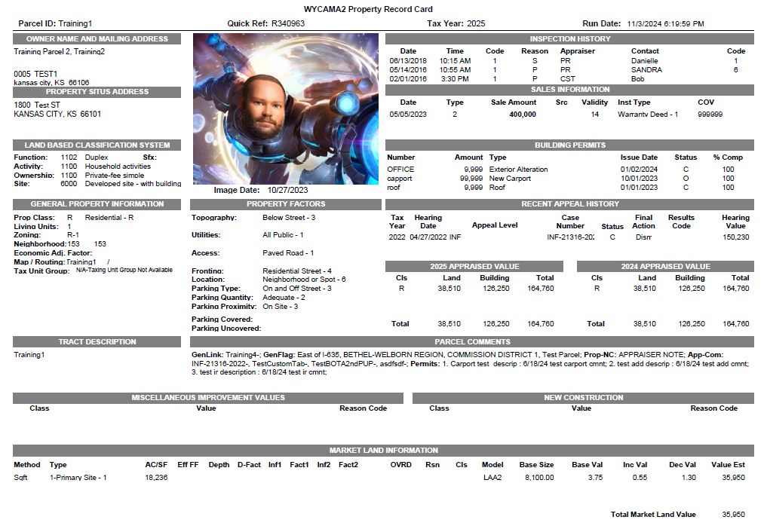
Sales History Property Record Card
.

Slide 6
2024 ORION USERS CONFERENCE
Sales History PRC
Pros
Cons
Sales History is not versioned – if changes are made to the sales history record at a later date, these changes would now display on the SH PRC.
Alternate workarounds would be free.
Photos & Sketches may not be options.
Can be generated quickly to compare data between Sales History and CAMA.
Alternate Solution: Transfer packet feature that is already in place and running only the PRC within the packet to create this “at time of sale” PRC.

Slide 7
Sales History PRC
What all would you want to see on the PRC?
Limitations
Sales History is not versioned

Slide 8
Sales Ratio Report Setup
Looking for more info on setting up a Sales Ratio Report? Scan this QR Code

